Slide 1
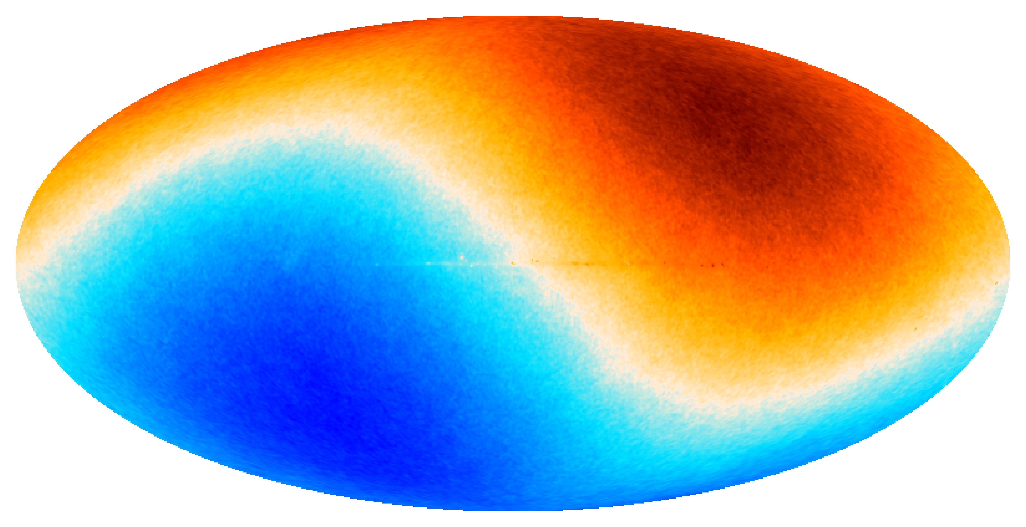





Bayesian Tension Quantification of the Cosmic Dipole Anomaly
achine
MaxEnt 2025, University of Auckland
M
A
I
L
earning
LAND-STRYKOWSKI^{1,2}
Oliver T. Oayda^{1,2}, Harry T. J. Bevins^{3,4},
Geraint F. Lewis¹, & Tara Murphy¹
¹Sydney Institute for Astronomy, The University of Sydney
²CSIRO Space and Astronomy, Australia
³Astrophysics Group, Cavendish Laboratory, Cambridge
⁴Kavli Institute for Cosmology, Cambridge
rtificial
ntelligence
mlan9395@uni.sydney.edu.au
MaxEnt 2025
0 / 14

Slide 2
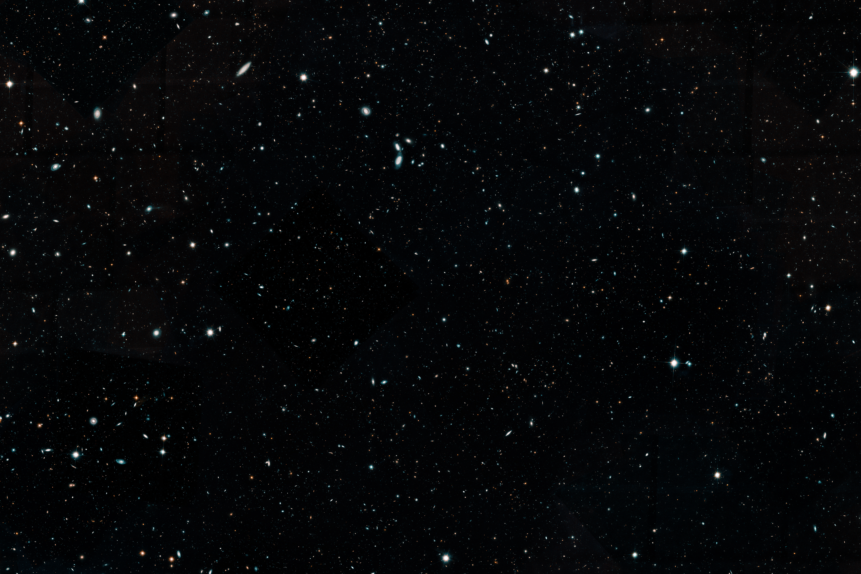
The Cosmological Principle

Slide 3
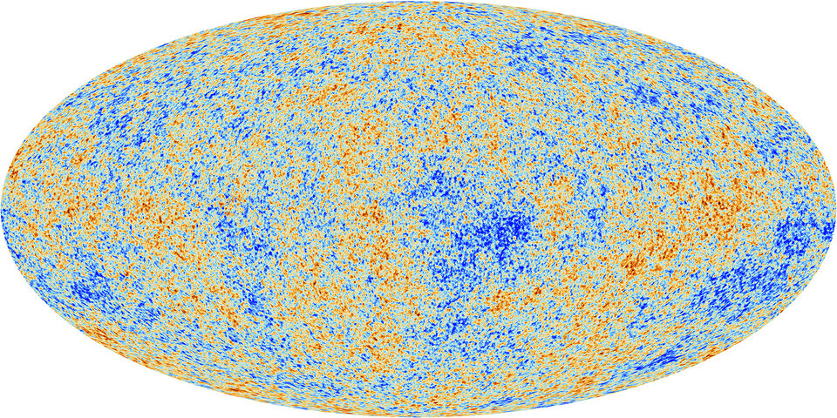

The Cosmic Microwave Background (CMB)
v ≈ 370 km/s
(𝑙, 𝑏) ≈ (264°, 48°)
Image credit: Planck Collaboration
mlan9395@uni.sydney.edu.au
MaxEnt 2025
2 / 14

Slide 4
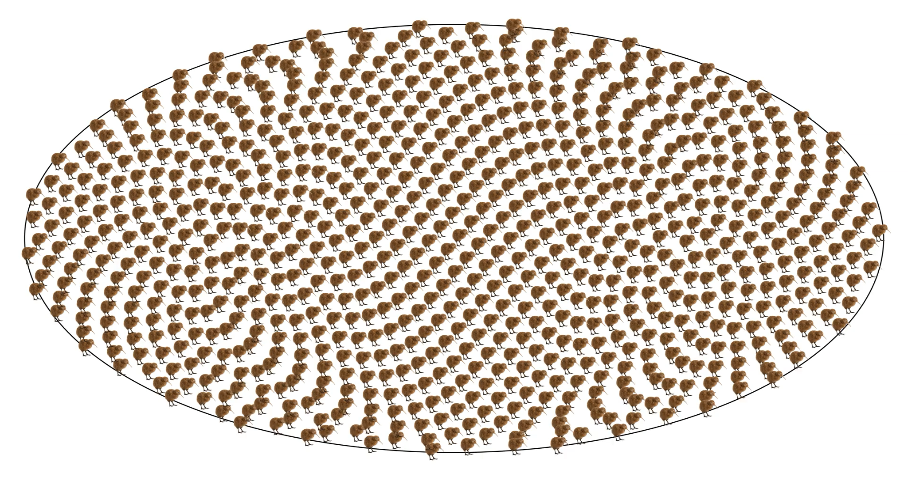
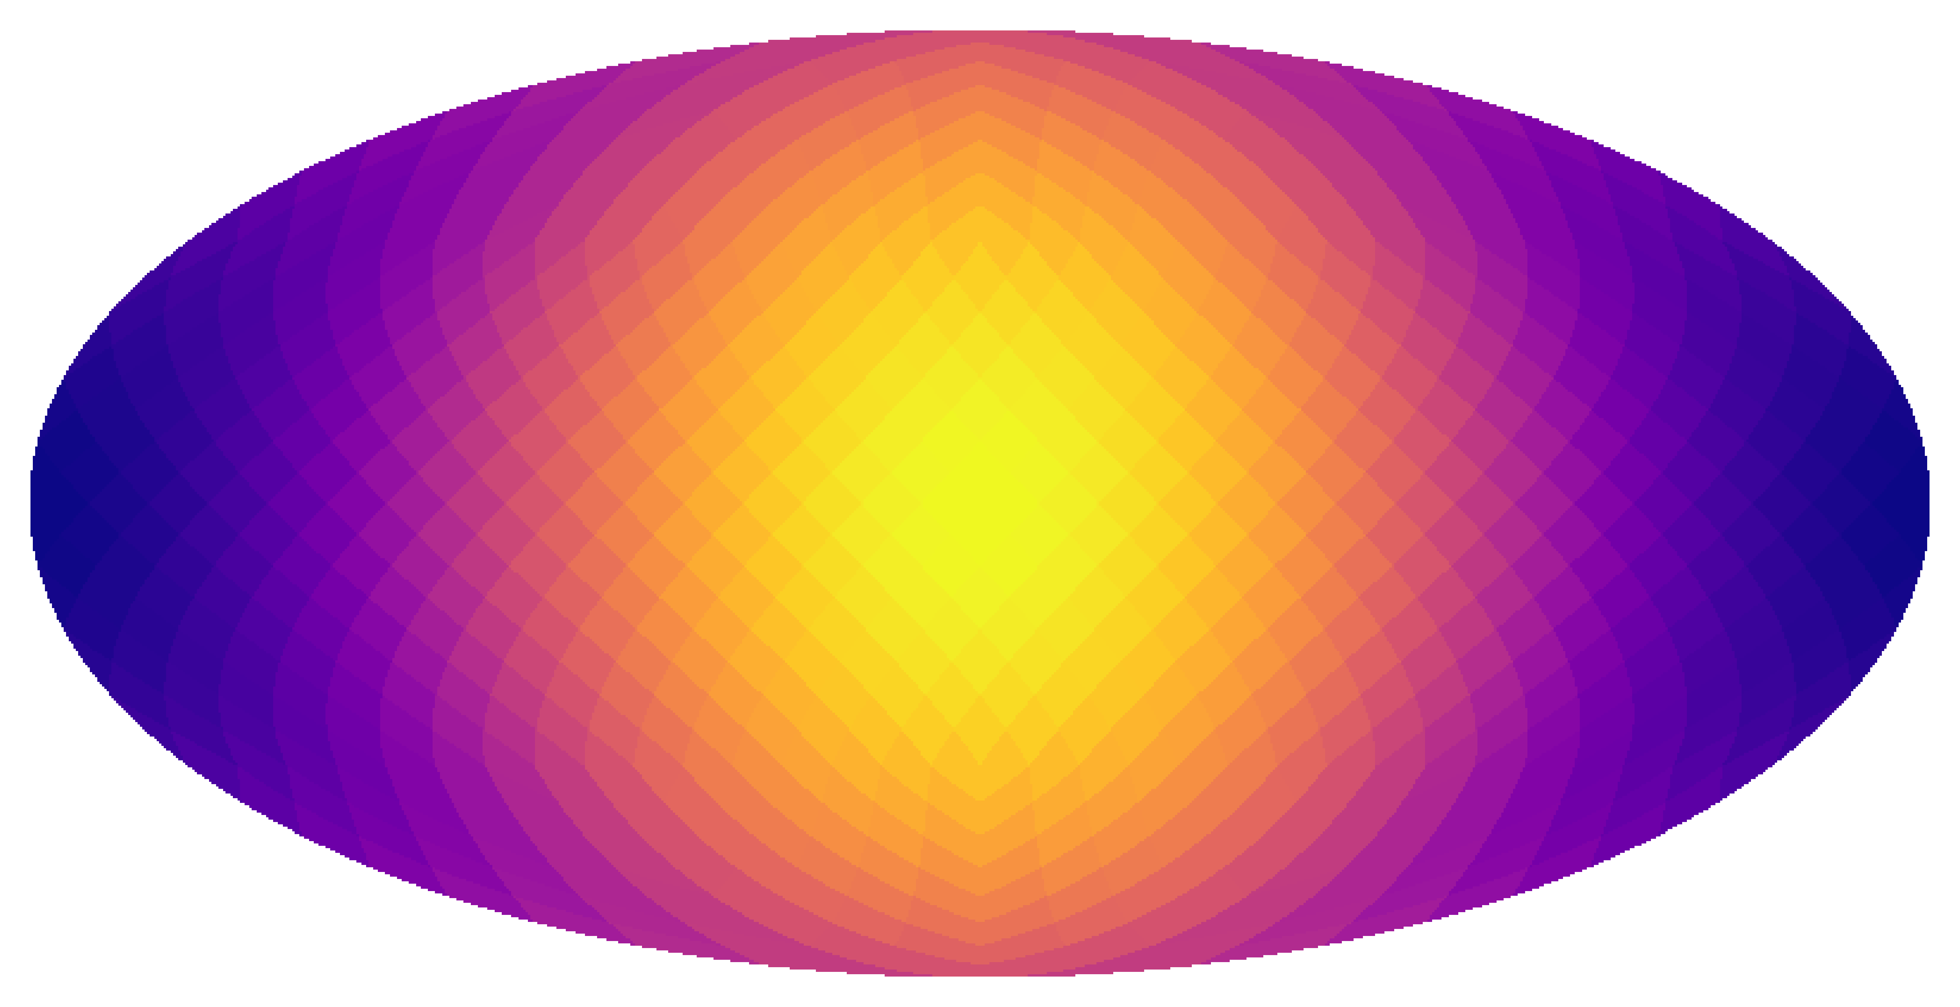
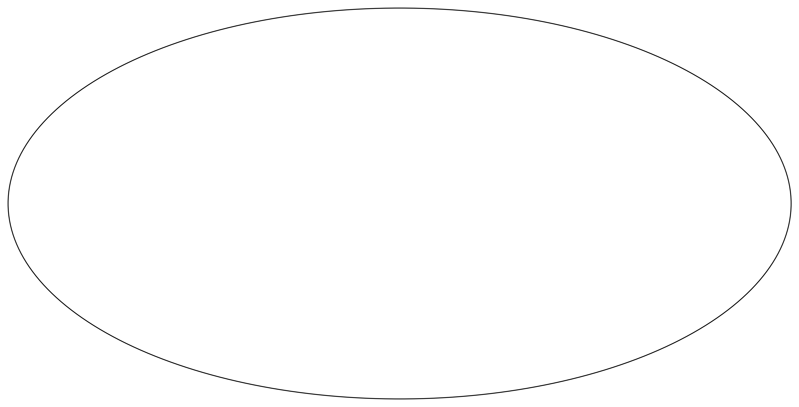
1. Relativistic Aberration 2. Doppler Boosting
mlan9395@uni.sydney.edu.au
MaxEnt 2025
3 / 14

Slide 5
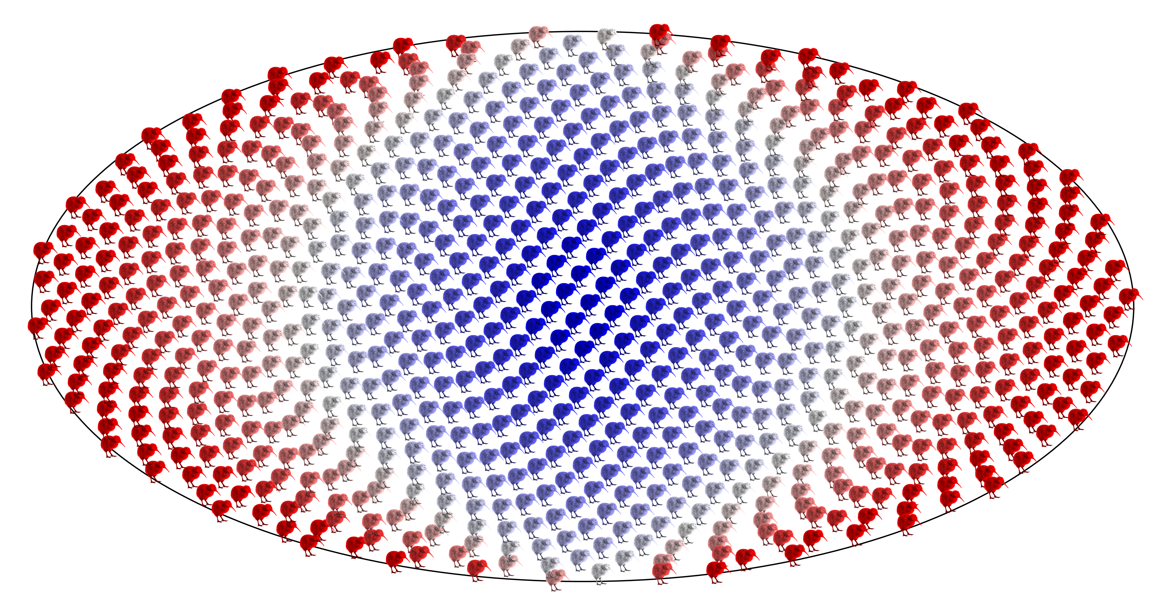
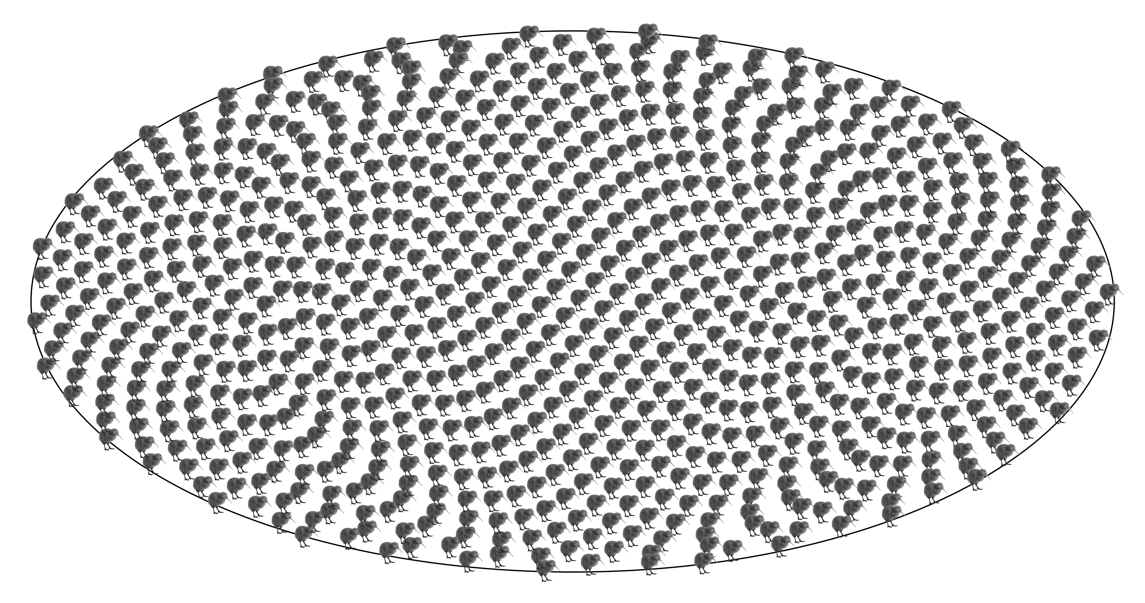
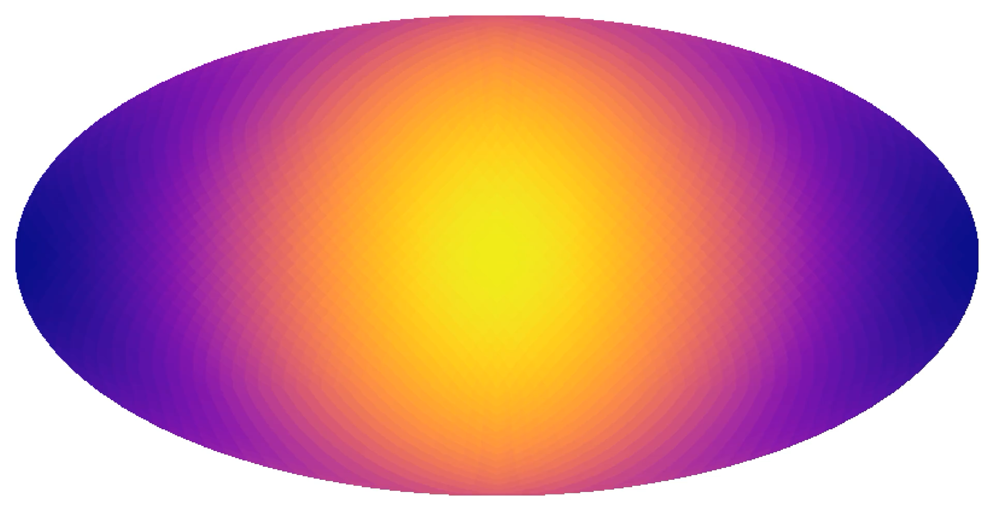
1. Relativistic Aberration 2. Doppler Boosting
mlan9395@uni.sydney.edu.au
MaxEnt 2025
3 / 14

Slide 6
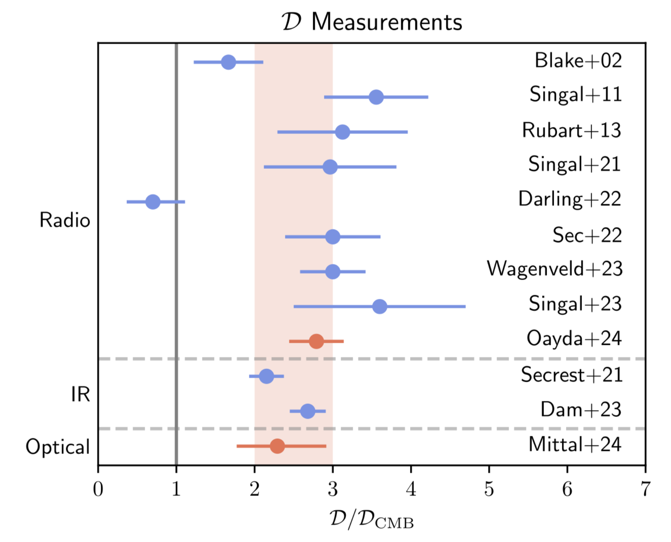
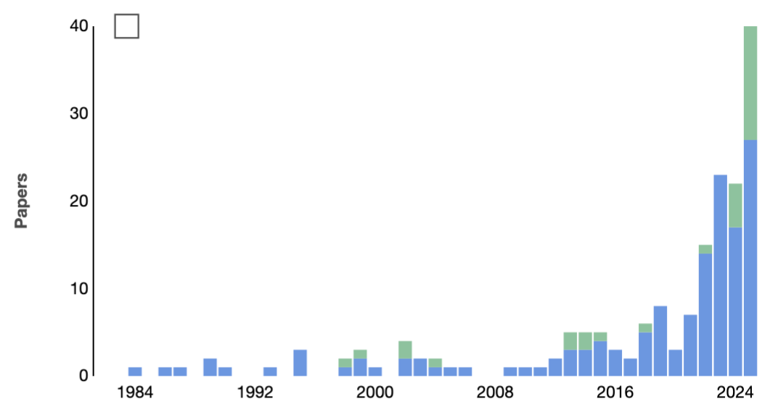
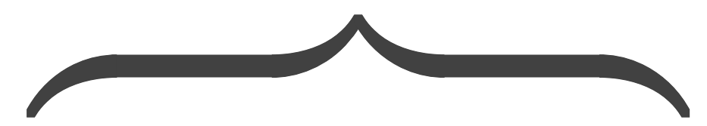
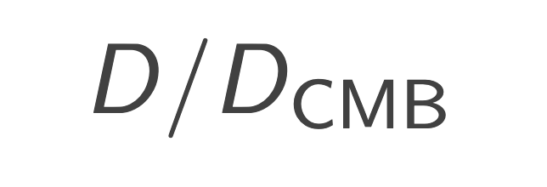
Houston, we have a problem
Popular misquote: Apollo 13, NASA
Dipole amplitudes exceed the expectation
Challenge against the standard model >5σ
Citations to Ellis & Baldwin (1984)
Refereed
Non-refereed
40
WISE results
Radio
30
Papers
20
Later radio analyses
NVSS published
IR
10
Optical
0
1
2
3
4
5
6
7
1984
1992
2000
2008
2016
2024
Image adapted from NASA ADS & Nathan Secrest
Image adapted from Oliver Oayda
mlan9395@uni.sydney.edu.au
MaxEnt 2025
4
9 / 14

Slide 7
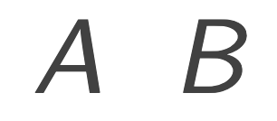
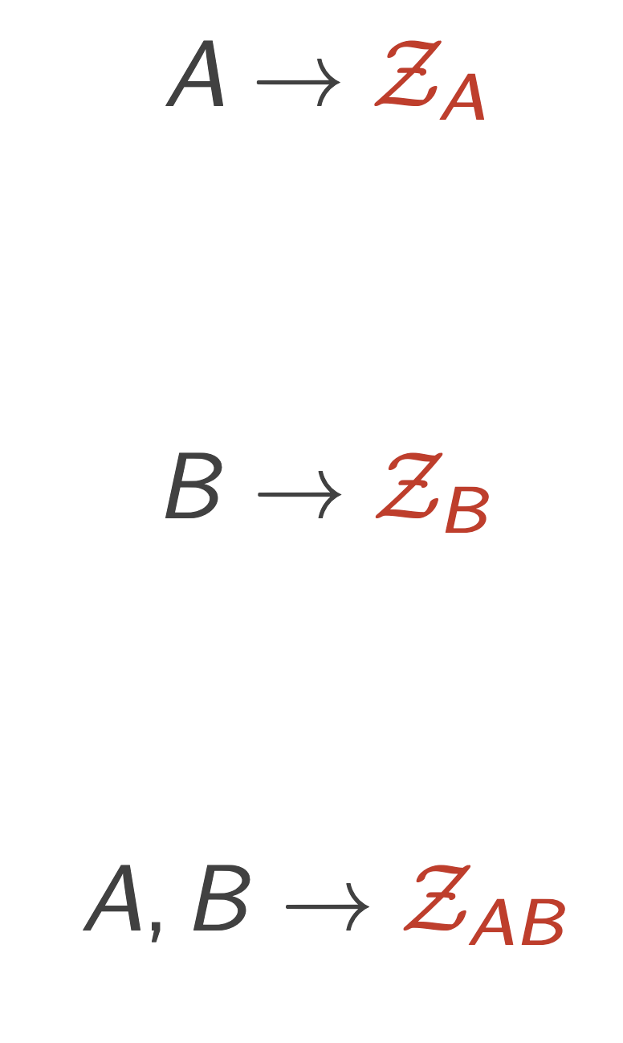
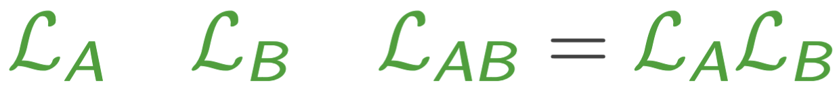
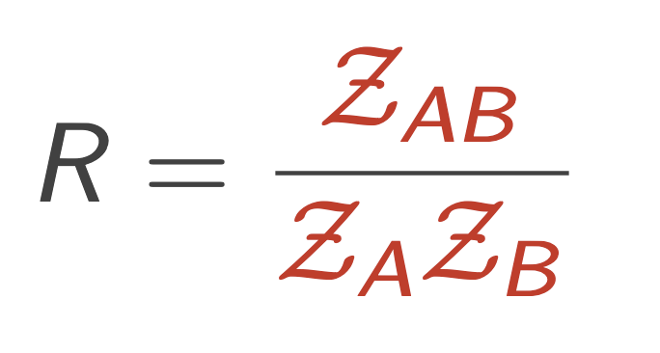
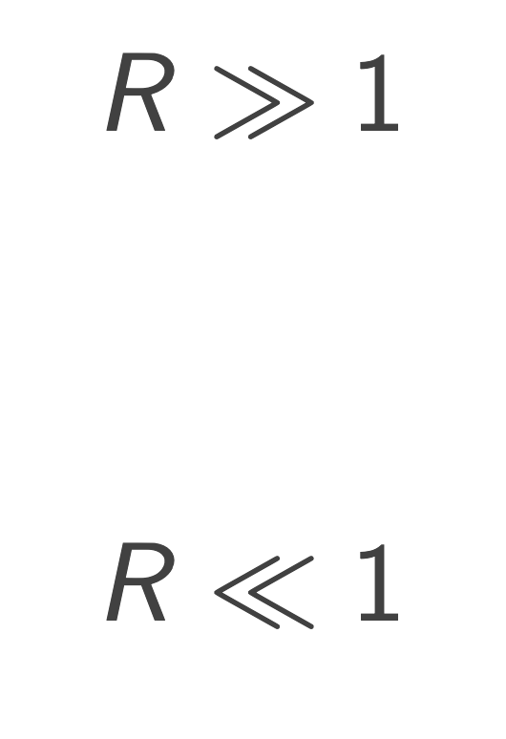
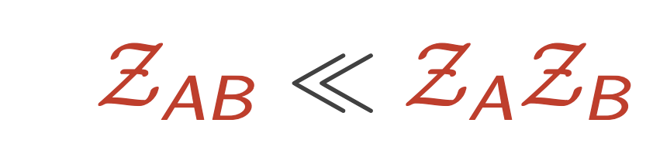
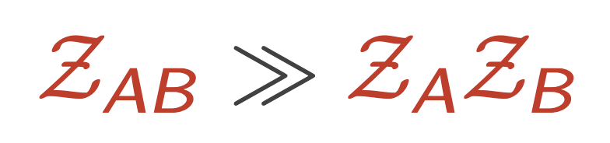
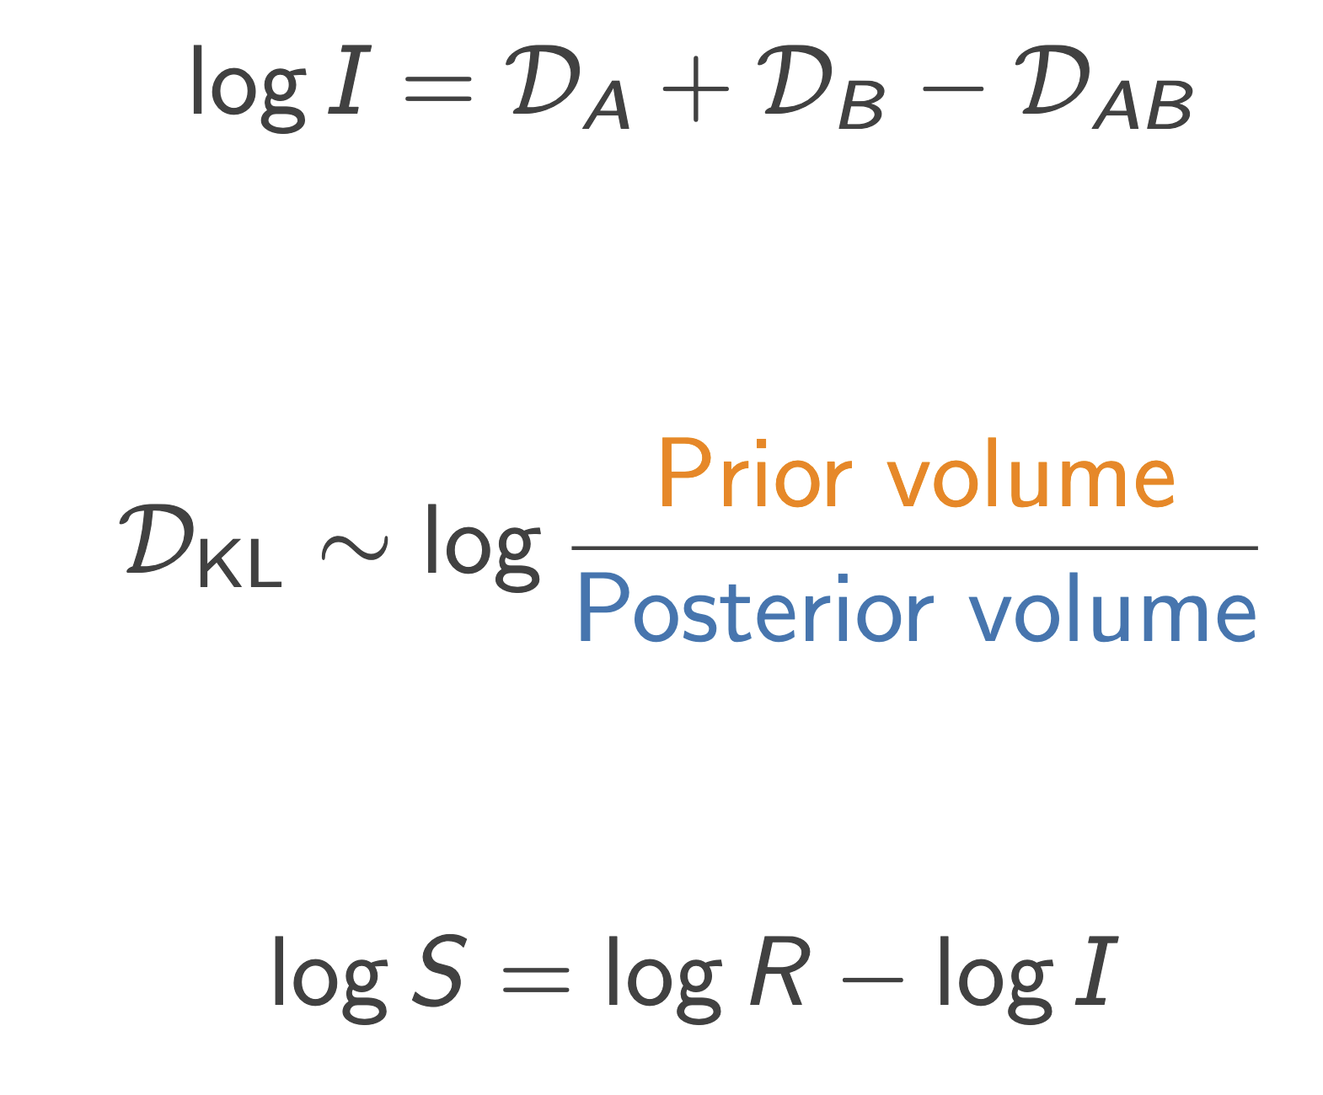
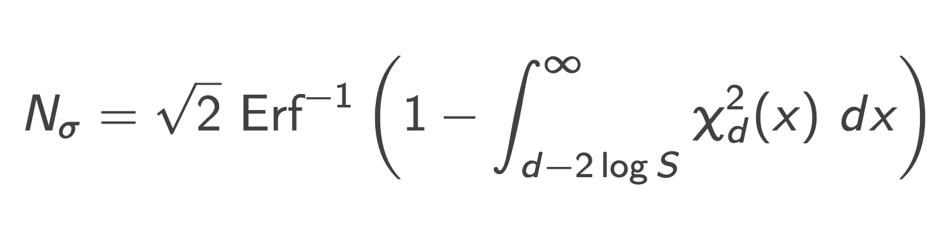
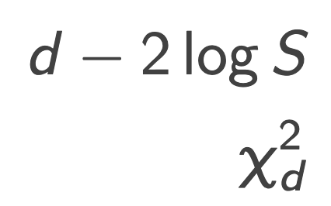
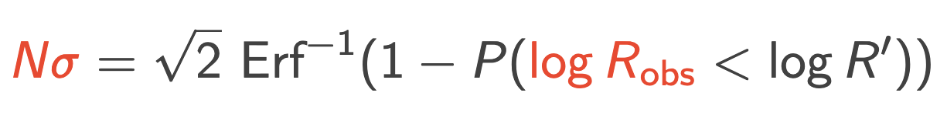
Marshall et al., 2006, Phys. Rev. D, 73, 067302
Handley W., Lemos P., 2019b, Phys. Rev. D, 100, 043504
Tension between data sets
For data sets and we need , , and (joint)
Use or for individual runs, use for joint run
Tension:
Concordance:
Get prior dependance:
Remove prior dependance:
Combining data sets decreases confidence
Combining data sets increases confidence
The quantity
follows a distribution
mlan9395@uni.sydney.edu.au
MaxEnt 2025
5
9 / 14

Slide 8
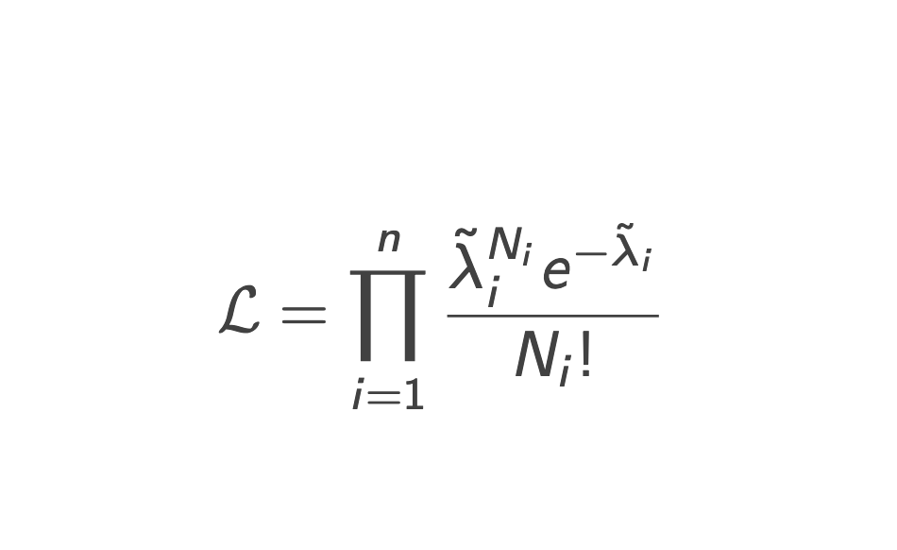
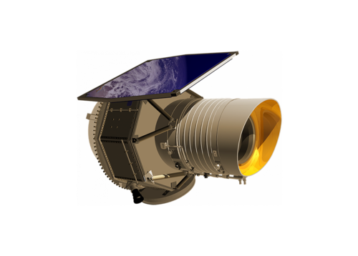
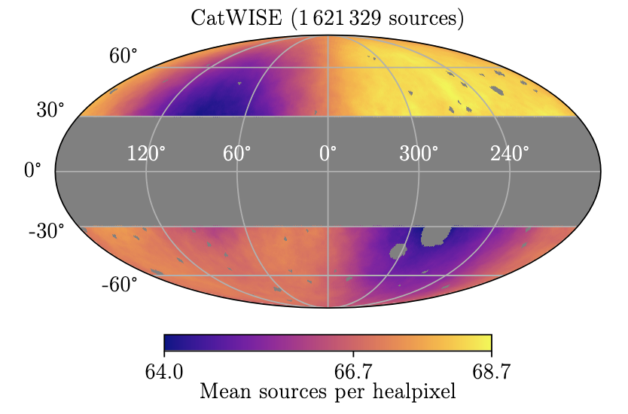
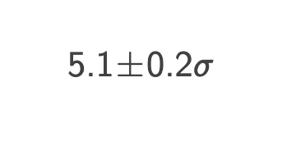
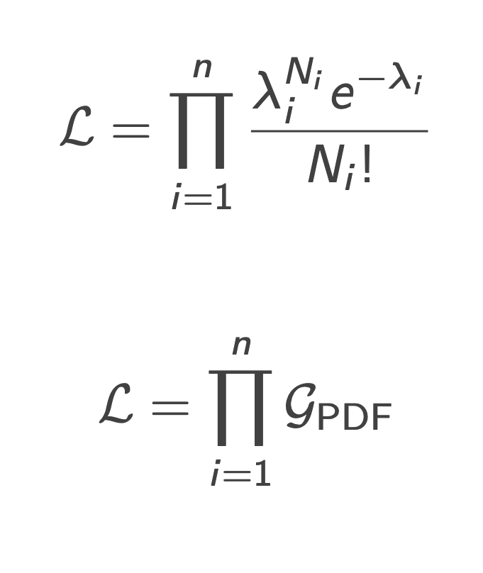
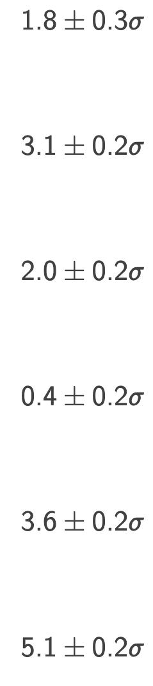
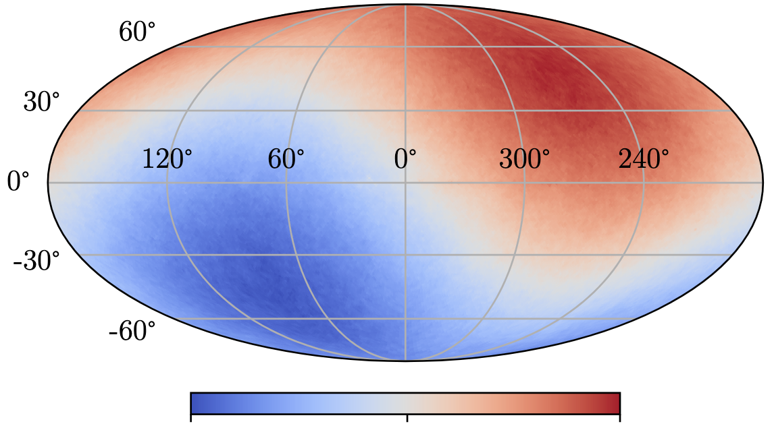
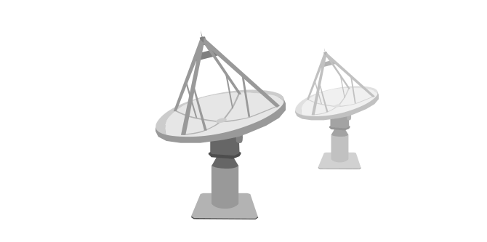
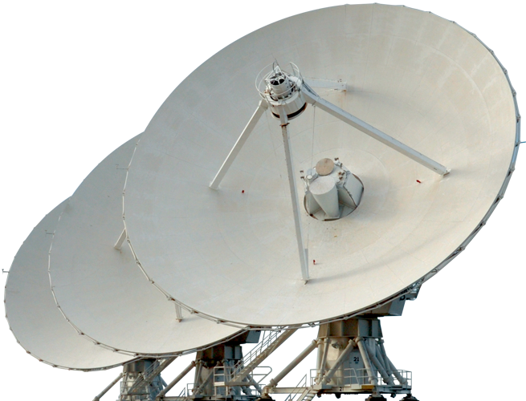
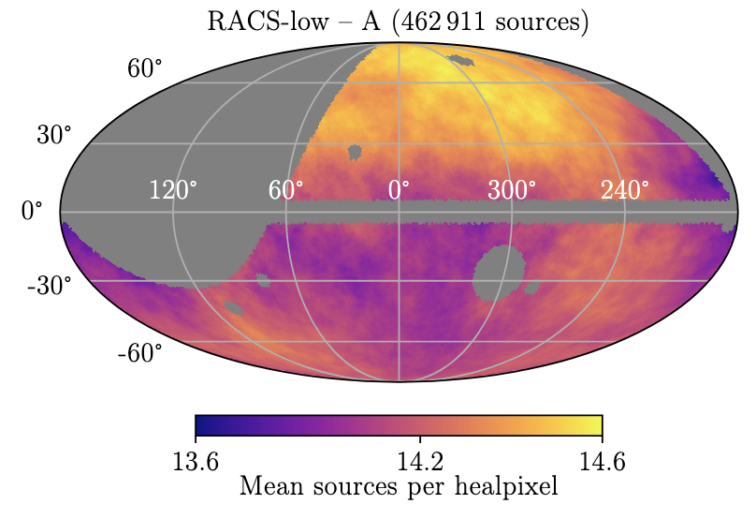
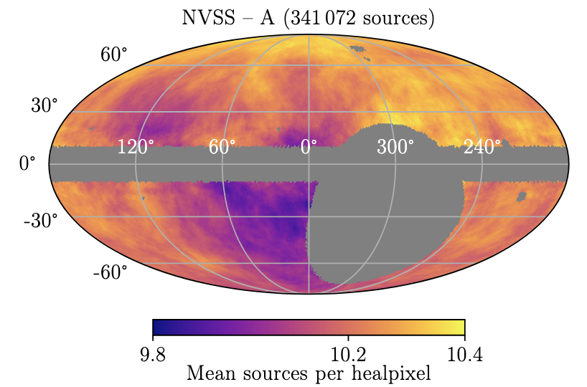
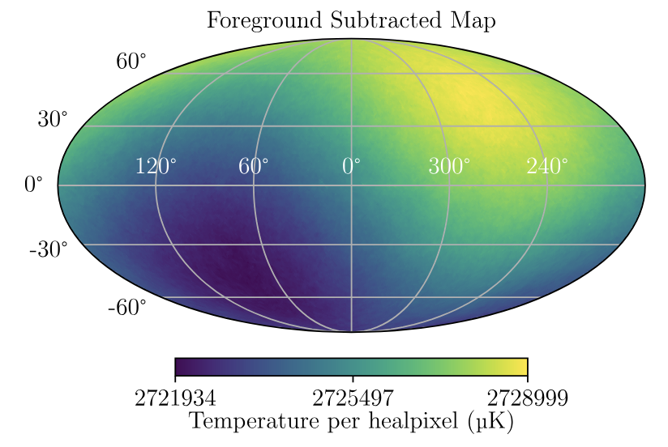
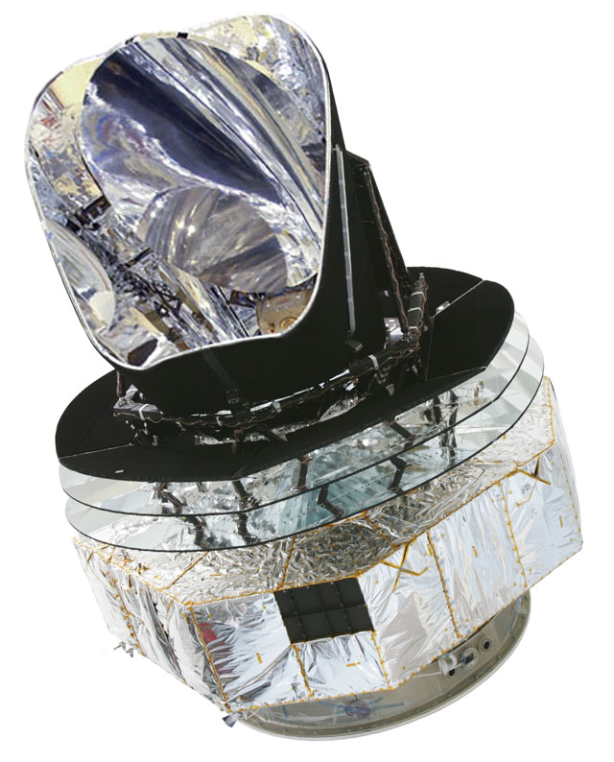
Land-Strykowski et al., 2025, MNRAS, 543, 3229-3241
CatWISE
CatWISE
W1 and W2
NVSS
RACS-low1
1.4 GHz
Planck
887.5 MHz
Planck
30 GHz
NVSS
RACS-low1
mlan9395@uni.sydney.edu.au
MaxEnt 2025
6
9 / 14

Slide 9
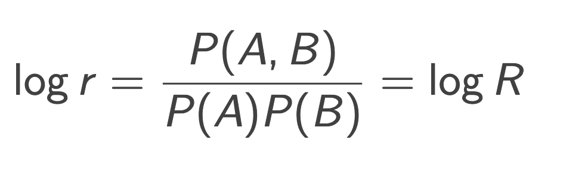
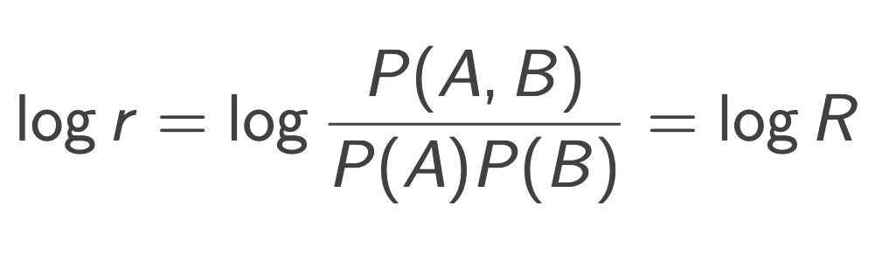
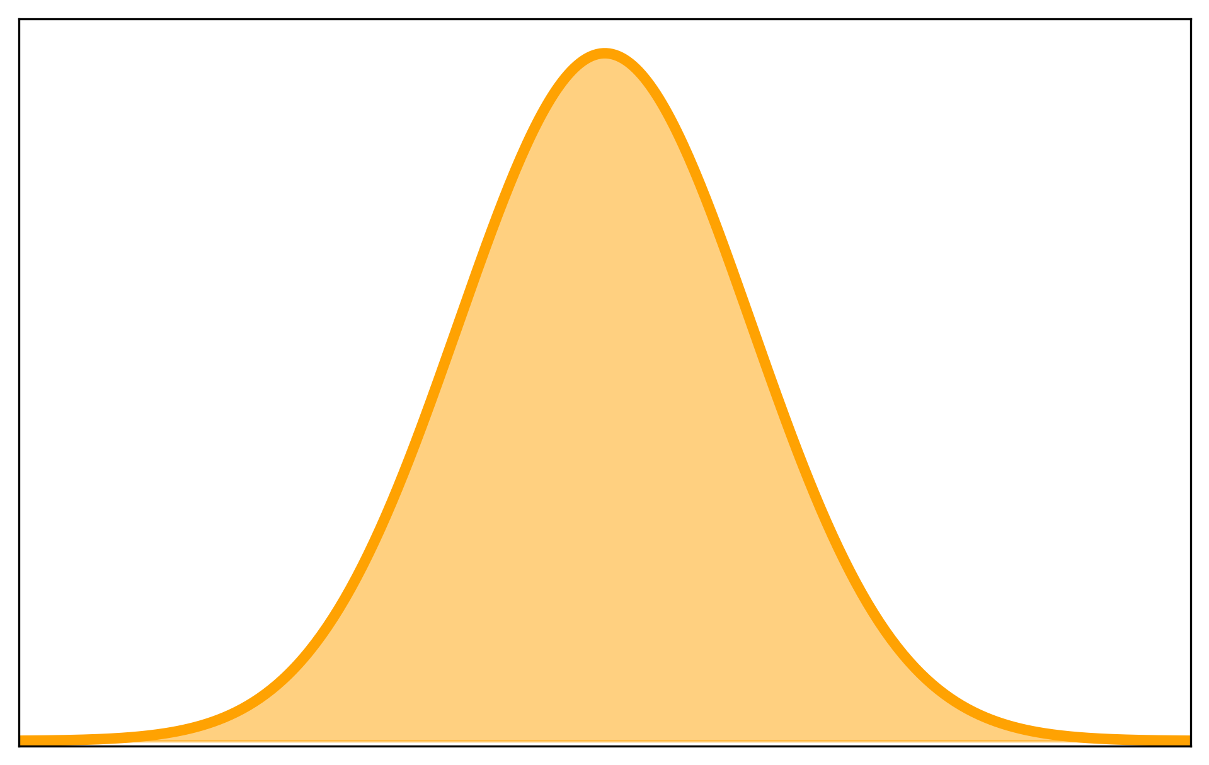
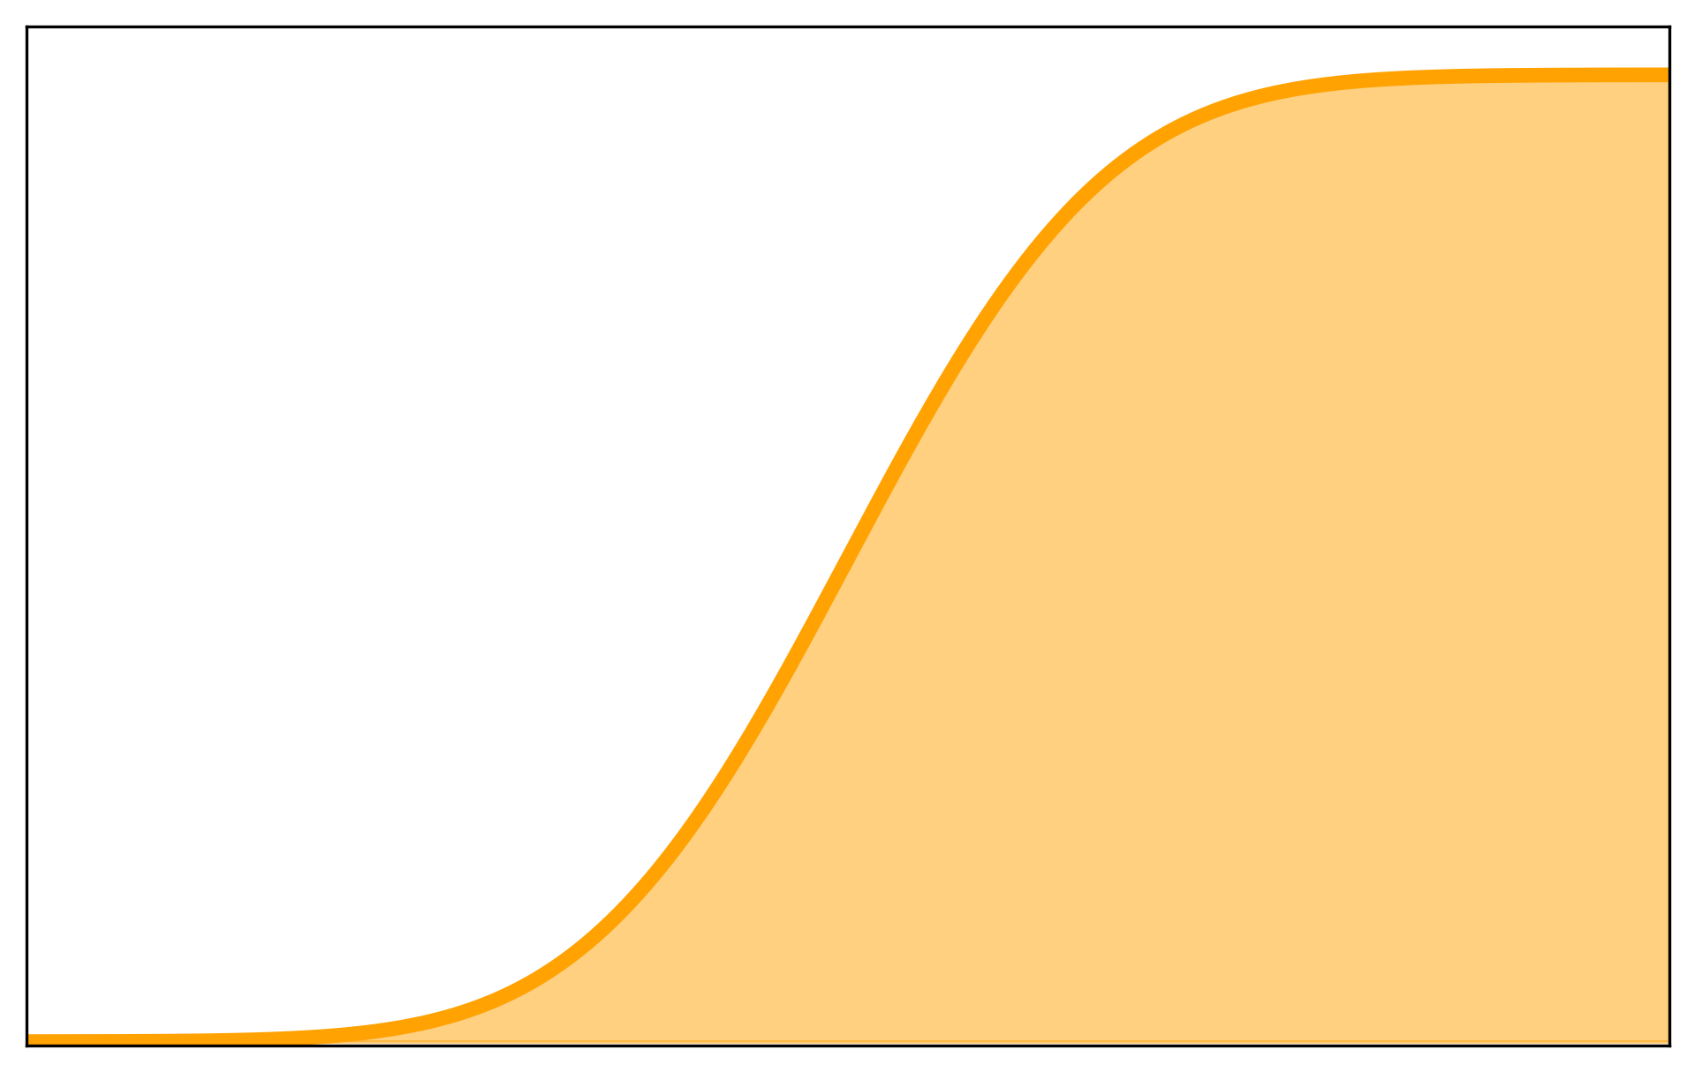
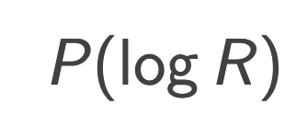
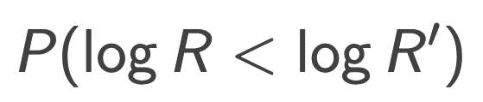
Tension with Neural Ratio Estimators (NREs)
Returns the probability that inputs and were drawn from their joint distribution relative to their independent distributions
If trained on an equal number of - pairs drawn from their joint and independent distributions, the output of the NRE tends towards
In Concordance
Distribution
Empirical CDF
Compute Tension
Bevins et al., 2025, Phys. Rev. D, 112, 043520
mlan9395@uni.sydney.edu.au
MaxEnt 2025
7
7 / 14

Slide 10
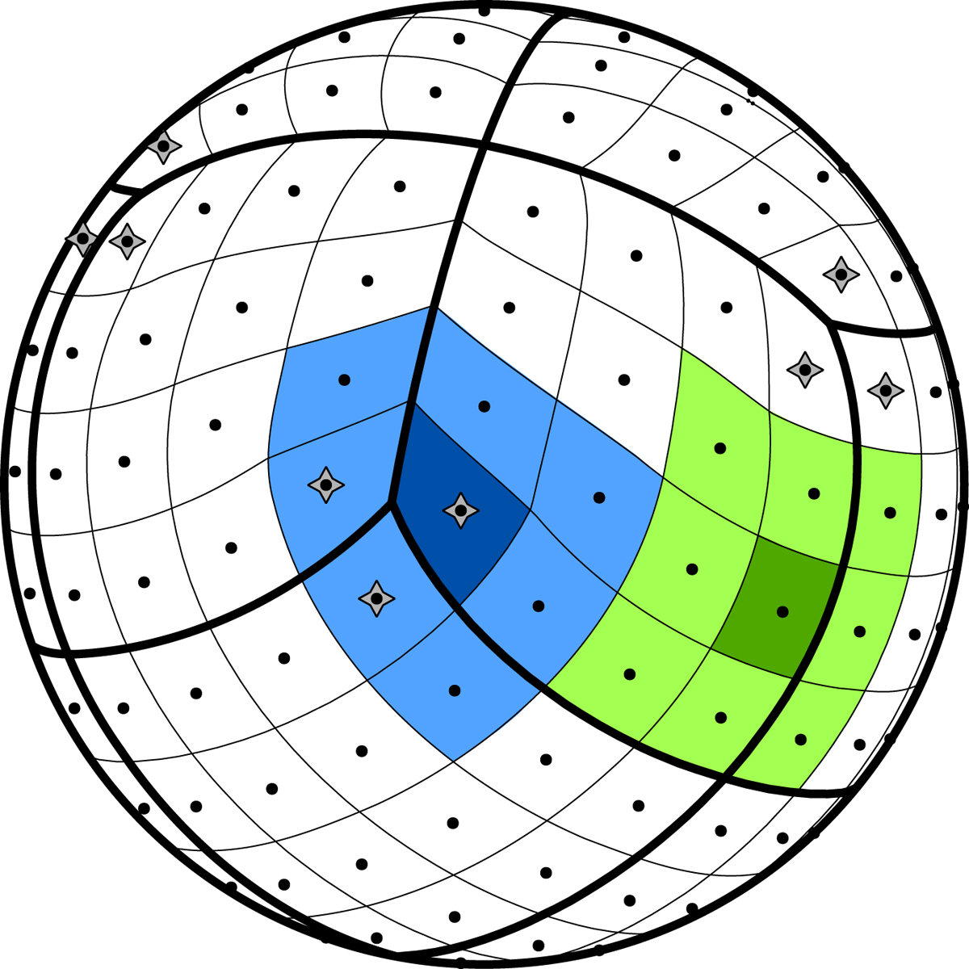
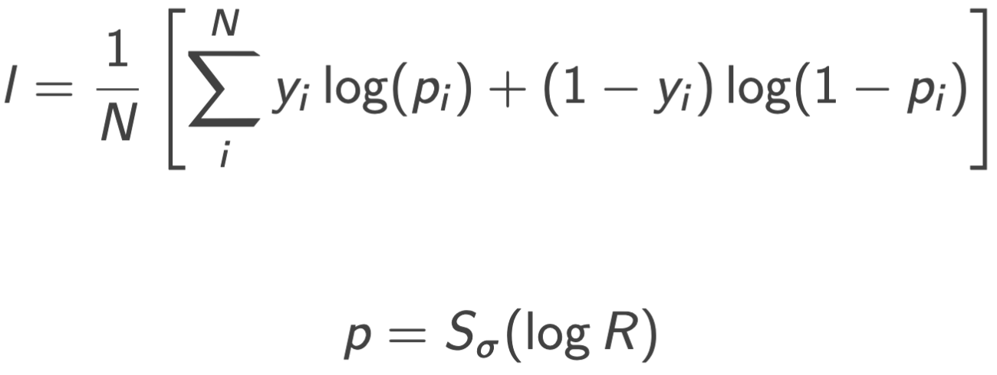
Building the Tensionnet (NRE)
Krachmalnicoff N., Tomasi M., 2019, A&A, 628, A129
Bevins et al., 2025, Phys. Rev. D, 112, 043520
ADAM optimiser
Learning rate of 10⁻³ decaying by 0.1 after 1000 epochs
Batch size of 6000
Early stopping with a patience of 50, monitoring val loss
Binary cross entropy loss function
with
Convolution Tower
Convolution Tower
49152 pix
192 pix
Extract features
Downscale maps
Extract features
Downscale maps
Fully Connected Network
The HEALPix Sphere
(use NNhealpix)
Land-Strykowski et al., 2026, in prep
mlan9395@uni.sydney.edu.au
MaxEnt 2025
8
9 / 14

Slide 11
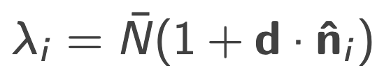
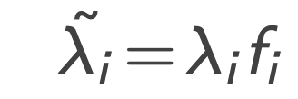
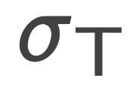
Building the Simulations
Simple kinematic dipole interpretation,
Planck
NVSS
RACS-low1
CatWISE
Gaussian( , )
Poisson( )
Poisson( )
Build 900,000 simulation pairs for each combination (60/30/10 split)
Select 10,000 concordant Planck–RACS-low1 pairs to validate with NS
Land-Strykowski et al., 2026, in prep
mlan9395@uni.sydney.edu.au
MaxEnt 2025
9
9 / 14

Slide 12
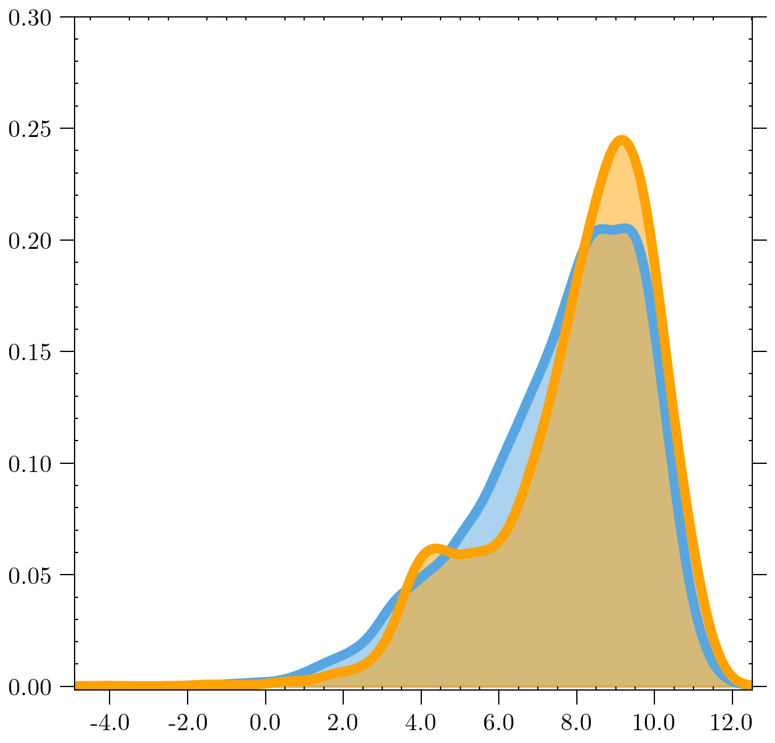
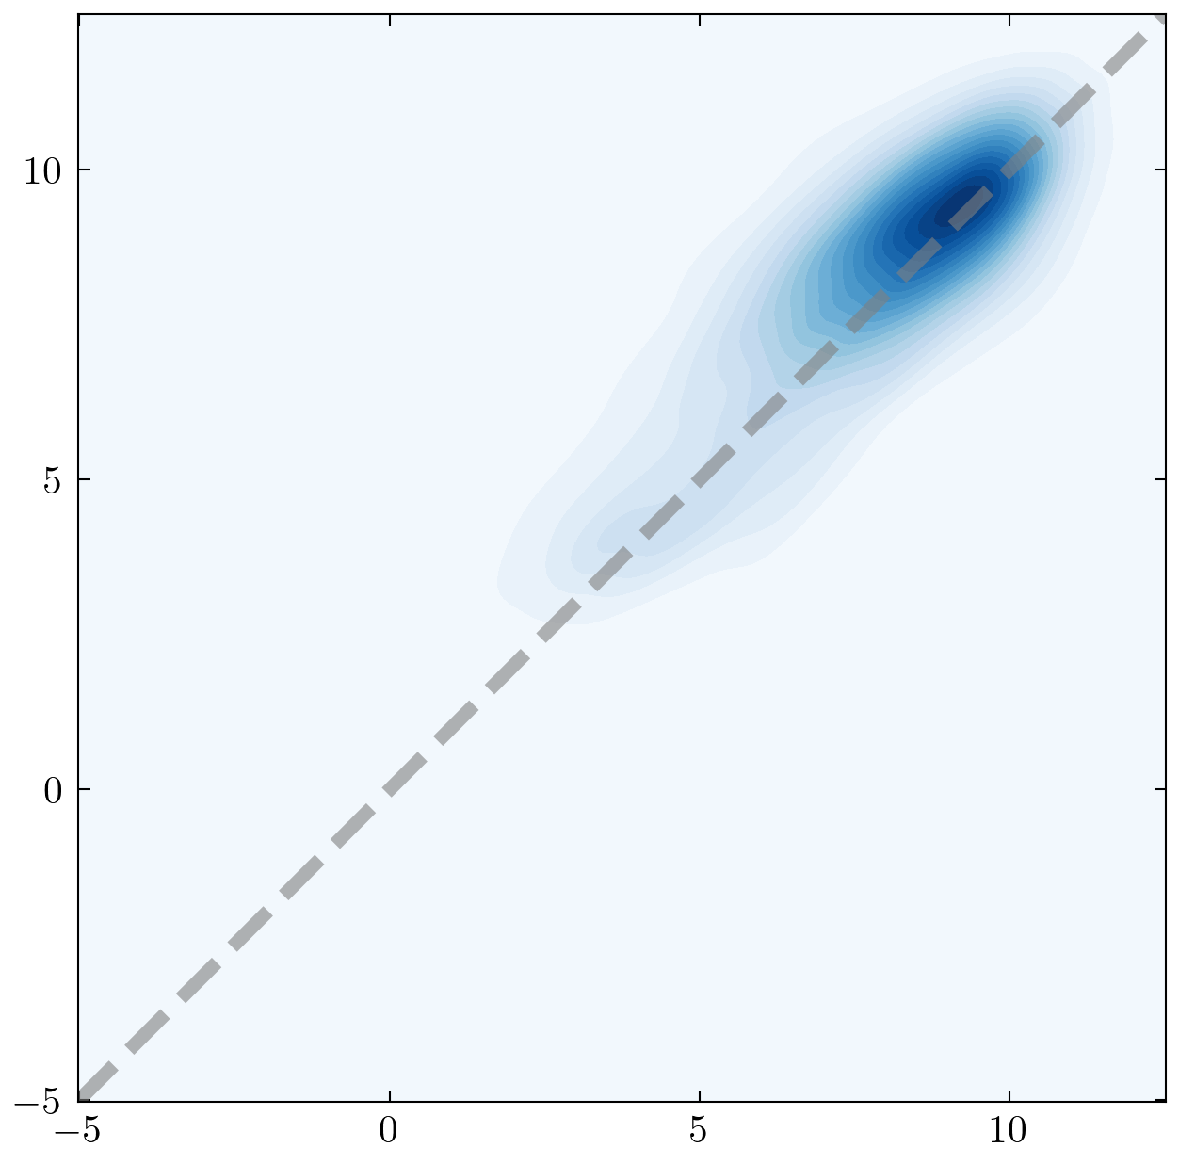




Validating the Tensionnet
Nested Sampling
NRE
Nested Sampling
Tensionnet
10
Tensionnet
Suspiciousness
PDF
5
PDF
0
$−$5
0
5
10
$−$5
0
5
10
2.8
3.2
3.6
NS
Tension (σ)
Land-Strykowski et al., 2026, in prep
mlan9395@uni.sydney.edu.au
MaxEnt 2025
10
9 / 14

Slide 13



Tension Comparison
Tensions are comparable.
Do the simulations capture the complexity of the data?
Suspiciousness
Tensionnet
Land-Strykowski et al., 2025, MNRAS, 543, 3229-3241
Land-Strykowski et al., 2026, in prep
mlan9395@uni.sydney.edu.au
MaxEnt 2025
11
9 / 14

Slide 14




Applying the Tensionnet to CatWISE Systematics
Ecliptic bias arises due to WISE’s scanning pattern
Previously modelled as a linear function
Oayda & Lewis (2025; submitted) simulate this as Eddington Bias
We build 900,000 simulations to train the Tensionnet (with Planck)
tension between
CatWISE and Planck
A reduction in tension from 5.1–5.5σ!
0
5
10
15
Land-Strykowski et al., 2026, in prep
mlan9395@uni.sydney.edu.au
MaxEnt 2025
12
9 / 14

Slide 15

Future of the Tensionnet
Use an ensemble to construct the in concordance distribution
Extend simulations to use a general Poisson form
Simulation cost: consider sequential training instead of amortised
Extend to more surveys, e.g. RACS-mid/high, EMU, LSST, Euclid, SKA-mocks
Böhme et al., 2025, Phys. Rev. Lett. 135, 201001
mlan9395@uni.sydney.edu.au
MaxEnt 2025
13
9 / 14

Slide 16



Summary & Conclusions
The cosmic dipole tension appears to be one of the most significant tensions and is reinforced by Bayesian Suspiciousness (arXiv 2509.18689).
We introduce a Tensionnet architecture purpose-built for dipole tensions on the HEALPix sphere.
Trained on simulations of Planck, NVSS, RACS-low1, and CatWISE, the Tensionnet reproduces tension measurements comparable with recent literature.
Applied to CatWISE simulations that model an Eddington-bias systematic, the Tensionnet uncovers a 3.8σ CatWISE–Planck tension (reduced from >5σ).
Is the Kiwiverse homogeneous and isotropic?
Given the need to enable systematics for current and near-future surveys, Tensionnets pave the way to untangling the cosmic dipole anomaly…
Thank you.
astromali.com/
mlan9395@uni.sydney.edu.au
MaxEnt 2025
14
9 / 14

